Slide 1
VIDEO GAMES RATING
ESRB
WALEED

Slide 2
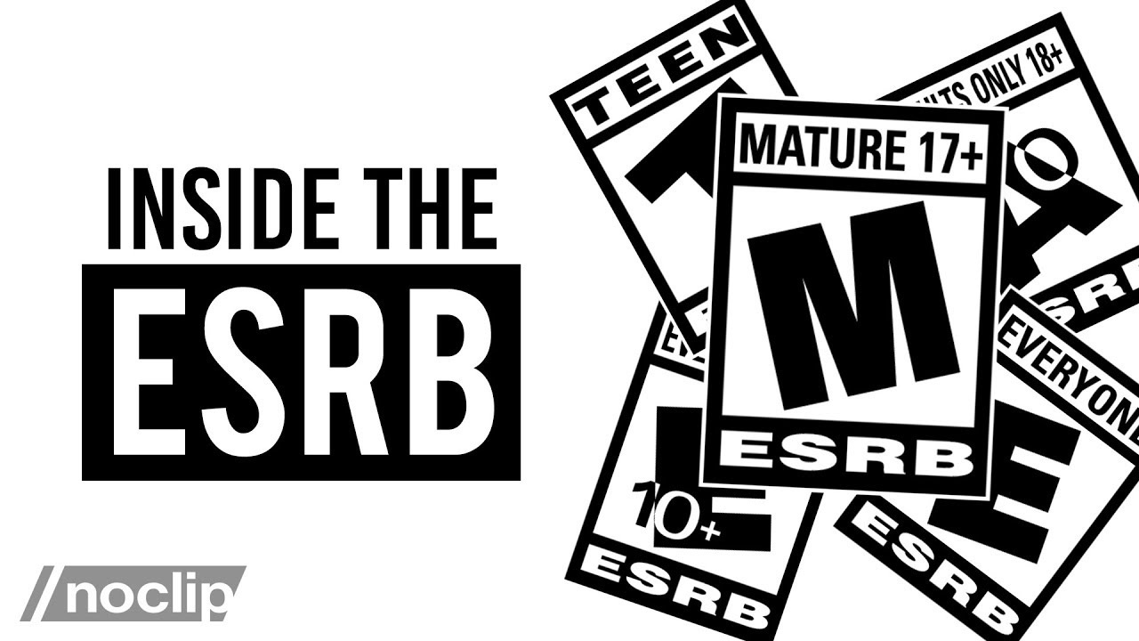
What is ESRB rating ?

Slide 3
Content of each video game
Alcohol Reference - Reference to and/or images of alcoholic beverages
Animated Blood - Discolored and/or unrealistic depictions of blood
Blood - Depictions of blood
Blood and Gore - Depictions of blood or the mutilation of body parts
Cartoon Violence - Violent actions involving cartoon-like situations and characters. May include violence where a character is unharmed after the action has been inflicted
Comic Mischief - Depictions or dialogue involving slapstick or suggestive humor
Crude Humor - Depictions or dialogue involving vulgar antics, including “bathroom” humor
Drug Reference - Reference to and/or images of illegal drugs
Fantasy Violence - Violent actions of a fantasy nature, involving human or non-human characters in situations easily distinguishable from real life
Intense Violence - Graphic and realistic-looking depictions of physical conflict. May involve extreme and/or realistic blood, gore, weapons, and depictions of human injury and death
Language - Mild to moderate use of profanity
Lyrics - Mild references to profanity, sexuality, violence, alcohol, or drug use in music
Mature Humor - Depictions or dialogue involving "adult" humor, including sexual references
Nudity - Graphic or prolonged depictions of nudity
Partial Nudity - Brief and/or mild depictions of nudity
Real Gambling - Player can gamble, including betting or wagering real cash or currency
Sexual Content - Non-explicit depictions of sexual behavior, possibly including partial nudity.
Sexual Themes - References to sex or sexuality
Sexual Violence - Depictions of rape or other violent sexual acts
Simulated Gambling - Player can gamble without betting or wagering real cash or currency
Strong Language - Explicit and/or frequent use of profanity
Strong Lyrics - Explicit and/or frequent references to profanity, sex, violence, alcohol, or drug use in music
Strong Sexual Content - Explicit and/or frequent depictions of sexual behavior, possibly including nudity.
Suggestive Themes - Mild provocative references or materials
Tobacco Reference - Reference to and/or images of tobacco products
Use of Alcohol - The consumption of alcoholic beverages
Use of Drugs - The consumption or use of illegal drugs
Use of Tobacco - The consumption of tobacco products
Violence - Scenes involving aggressive conflict. May contain bloodless dismemberment
Violent References - References to violent acts

Slide 4
Workflow
EDA
Results
Feature
Eng.
Modeling

Slide 5
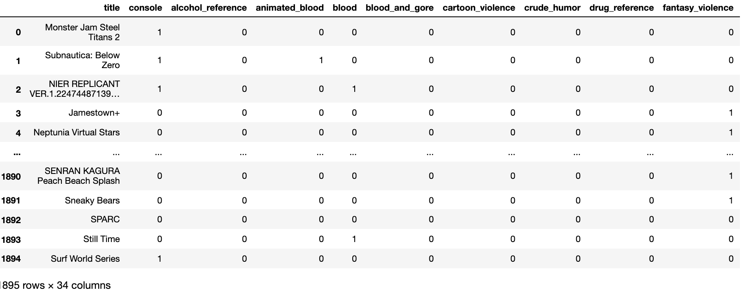
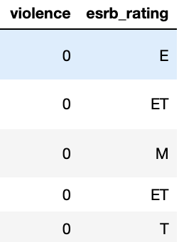
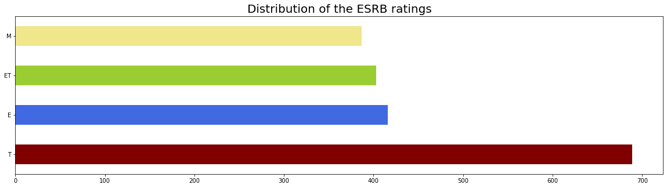
EDA
M: Mature 17+ -- 387
ET: Everyone 10+ -- 403
E: Everyone -- 416
T: Teen -- 689

Slide 6
Feature Engineering
Imputation
Dummies
Scaling

Slide 7
Modeling
Not Scaled
Scaled
Train Acc | Test Acc | Train Acc | Test Acc
0.877 | 0.830 | 0.862 | 0.814
0.8580 | 0.800 | 0.865 | 0.818
0.9176 | 0.826 | 0.9176 | 0.826
0.9176 | 0.850 | 0.9176 | 0.850
KNeighborsClassifier
LogisticRegression
DecisionTreeClassifier
RandomForestClassifier

Slide 8
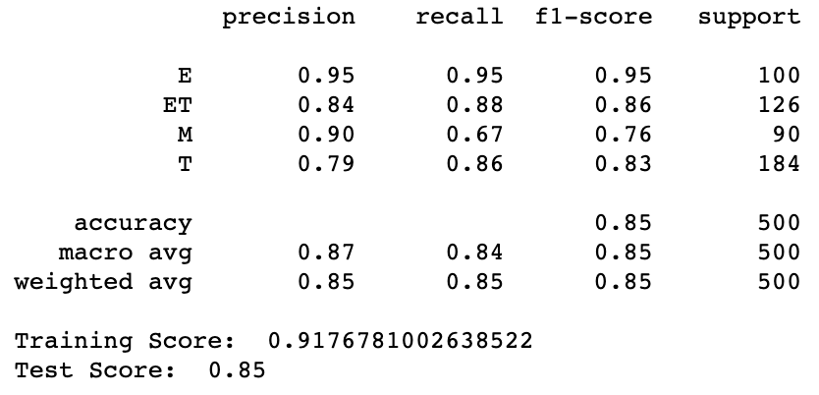
Results
As we saw the RandomForestClassifier was the model that scored the highest Accuracy ..
And here Is the classification report for our RandomForestClassifier:

Slide 9
Conclusion
Classify the appropriate ESRB rating for each game.
Develop the best classification model.
Safer gaming environment for each family.

Slide 10
ありがとうございました

